Slide 1

FCSPA On-site contests
66th Annual FCSPA Conference
Ocala, FL
November 12-15, 2025

Slide 2

Fiction

Slide 3
Winners
Third Place
“Chase Moore and the Hot Pink Demons”
Thomas Reed, College of Central Florida

Slide 4
Winners
“These flamingo-dragons were a mysterious species that challenged everything once known about biology. But anyone that dared get close had disappeared. Bodies never found. For this reason, nobody had ever seen a decent photo of the beasts.
###
That was until a rogue journalist came to town. […] ‘Meet me at the vacuum store, if you dare.’ [the note] read. […] Bodies hung from the ceiling, all with ‘Missing’ posters attached.
###
An old man with a cowboy hat stepped into the light. He was holding a chain that stretched into the dark. When he gave it a pull, his monstrous pet drew near. It was one of them.
The villain cackled loudly. ‘Looks like old Chase is about to become ... no Moore!’"

Slide 5
Winners
SECONd Place
“Rosalyn’s Purpose”
Arwen Frye, Daytona State College

Slide 6
Winners
“Roslyn was now a junior in college, representing her school's newspaper at FCSAA. Even through her long suffering, she chose to follow in [her dad’s] footsteps, keeping [his] vision alive, only shooting on film, using his cameras.
###
Upon opening the package, she found a box of film with ‘Forever’ written on the outside of the box. Without hesitation, she loaded the film into her camera. […] Throughout the conference, Roslyn was shooting with this roll of film.
###
[Back at home,] when the process was finished and photos were complete, Roslyn was left speechless at the results. Her father was there, in every photo, smiling beside his daughter.”

Slide 7
Winners
first Place
“Behind the Door”
Pearl Wilburn, Florida Gateway College

Slide 8
Winners
“It said that they were coming. Those with teeth and claws to rend flesh from bone. Creatures with glowing eyes that hunt in the dark.
###
My body hits the bed and suddenly she is on me, laughing at my struggle to escape. She calls for the beast and it heeds her.
###
I remember what the note said: ‘Cat adoption downstairs. I'll be back with a new friend soon!’ With a little kitten blowing kisses drawn in the corner. The cat cuddled closer to my chest, and I knew I would never escape my greatest enemy. I would never know peace and clear sinuses again.”

Slide 9

poetry

Slide 10
Winners
Third Place
Arwen Frye, Daytona State College
“Too Little, Too Late”

Slide 11
Winners
fire is burning all around us
can you smell the smoke?
replacing our green with gray
do you see the dust?
ocean blue is turning red
can you taste the blood?
a skeleton of what once was
the deal’s already done

Slide 12
Winners
SECONd Place
Maria Jose Rojas Zapata, Florida State College at Jacksonville
“Voices”

Slide 13
Winners
This room hums with voices,
Angry melodies
That fill my ears and body with fearfulness.
They remind me of the past,
Of what I had and
What I have lost.
This room hums with voices,
Hunting me, following me.
I can hear them, I can feel them.
This room hums with voices,
But they are all mine
And I can’t stop them.

Slide 14
Winners
first Place
Amanda Rigazio, Daytona State College
“Ballad of Seeds”

Slide 15
Winners
This room hums with voices behind closed doors, you’d think there was a fiery political debate This room hums with voices the atmosphere encourages sprouting students clinking glasses with triumph This room hums with voices the front desk lady at the Marriott is unhappy with us | This room hums with voices beginner adults mindfully creating their futures, security in their thoughts This room hums with voices the fluorescent bulbs engulf us, the way we’d like our dreams to This room hums with voices laughter meeting smiles accompanied by tongues This room hums with voices chemically balanced brains entwining

Slide 16

photography

Slide 17
Winners
Third Place
Talafia English, Daytona state college
A simple yet compositionally complex image that relies on a series of diagonals, triangles and other linear shapes that all engage the viewer's attention. In addition, the red and blue are complementary colors that are pleasing to the eye.

Slide 18

Winners
Reconstruction. Taken at the Hilton hotel in Ocala

Slide 19
Winners
SECONd Place
AshTON Guitard, Daytona state college
Extraordinary view of starry sky and landscape, with the off-center circle of stars well placed; the artificial lights on the trees and lawn round out the composition nicely.

Slide 20
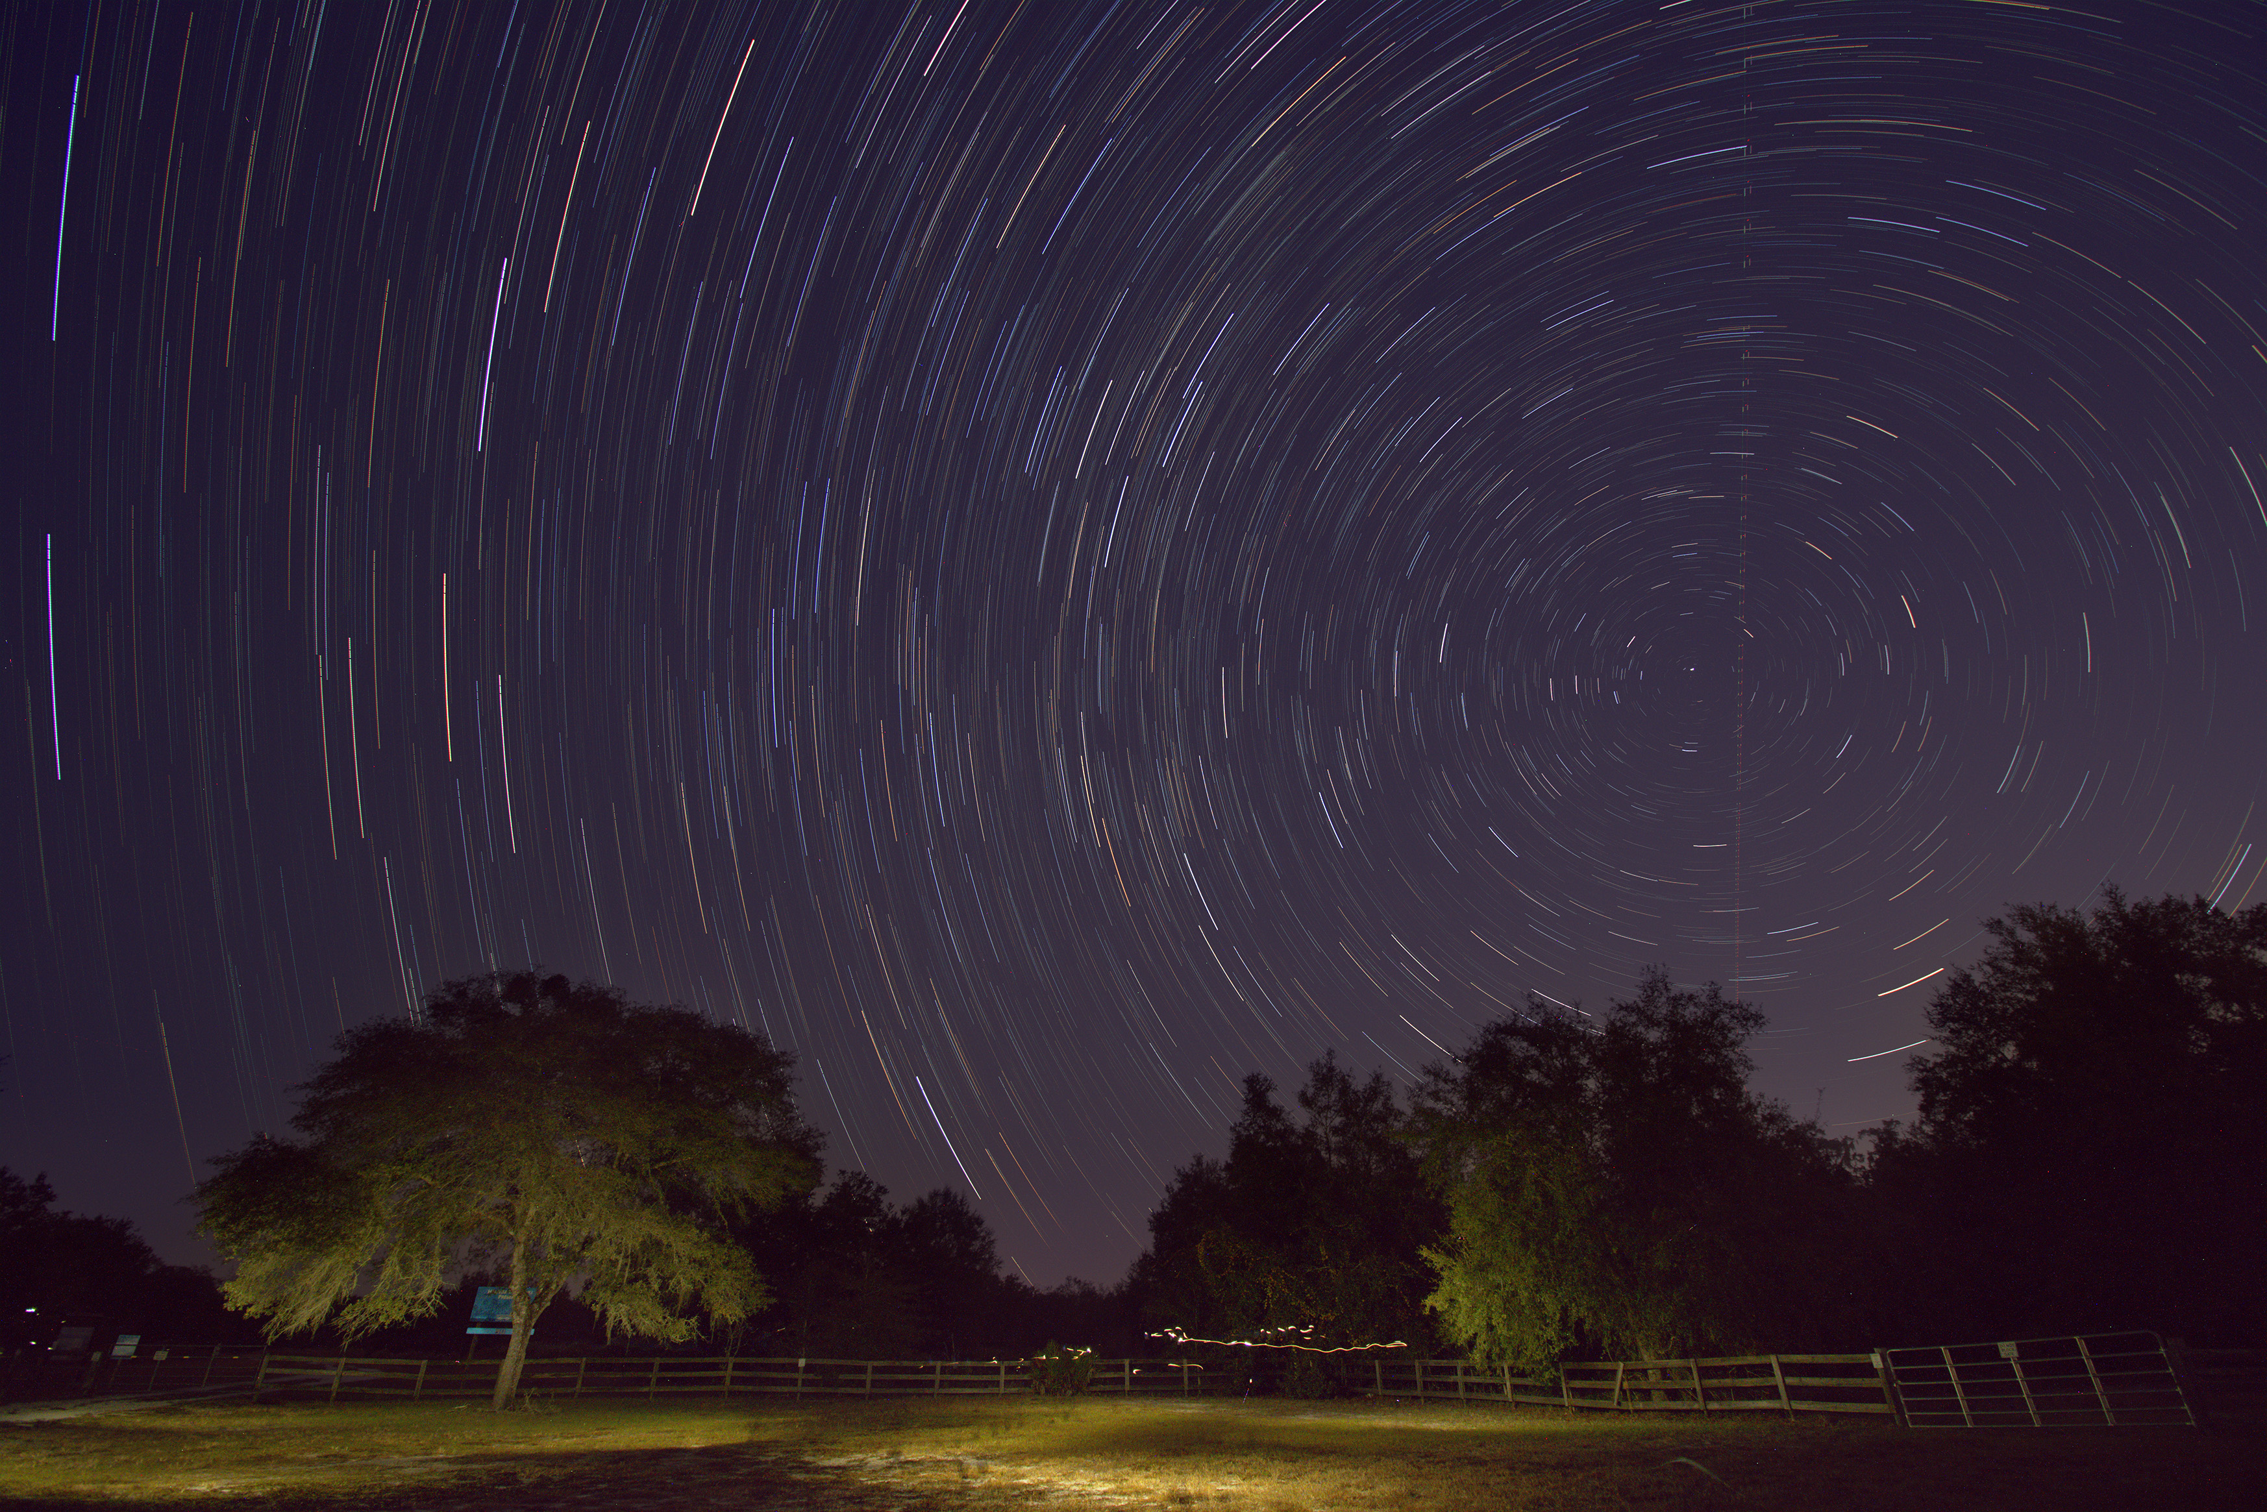
Winners
"Centered on Polaris" - A Field, Ocala

Slide 21
Winners
first Place
Samantha Criscuolo, Daytona state college
Beautiful light on this figure in a very natural pose with a terrific view of the face; the background was handled well with depth of field, composition fills the frame.

Slide 22
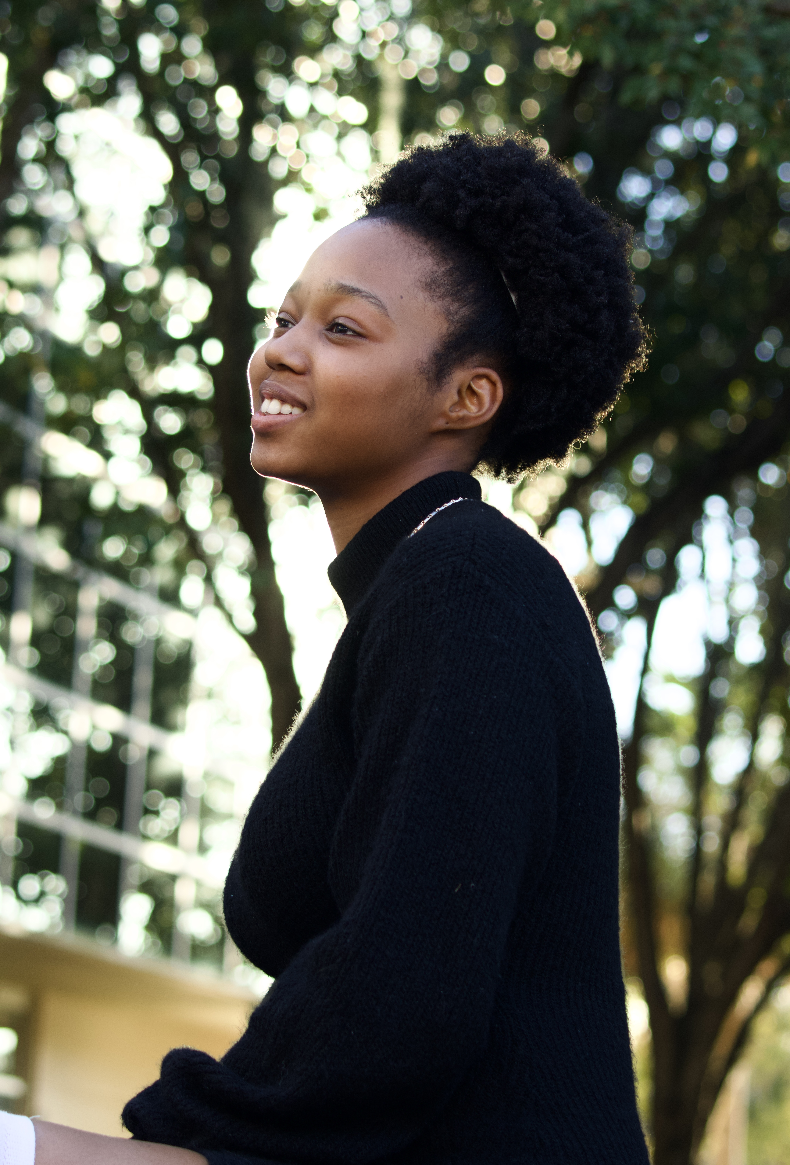
Winners
“Sunny Shining,” taken outside the client conference center on the CF campus

Slide 23
People’s choice

Slide 24
Winners: best overall magazine
Panku

Slide 25
Winners: best design
Panku

Slide 26
Winners: best literature
Panku

Slide 27
Winners: best artwork and photography
The Experience

Slide 28

Congratulations!

